Slide 1
Vitamin Personalizer Presentation
Personalized Health Recommendations According To Lab Analysis
By: Nhat-Huy Tran, Jonathan Yunes, and Ahmet Ege Aytac
Wellness Wizards
July 22 ,2025

Slide 2
Pages Overview
Introduction
Overview
Problem statement
Solution
Target Users
System Architecture Design
UML Diagram
Use Case Diagram
Software Components
System requirements

Slide 3
Problem Statement
Modern Problem
Many sickness and health problems occur due to lack of nutrition and vitamins
Today’s world relies heavily on fast food and frozen products
Difficult to obtain essential nutrients from modern eating habit
Communication problem
Lab test results show health problems but are hard to read and understand
Expert interpretation required for most people
Results may have hidden connections that cause health issues
Complex relationships between lab results

Slide 4
Solution
Software that:
Identifies which vitamins are lacking with checking 50 lab results
Calculates Body Measurement Index (BMI)
Recommends specific vitamins and diet plans users should follow without experts
Uses data from known clinics and health organizations
Provides most accurate health information available

Slide 5
Target Users
Primary Users:
-Individuals with dietary restrictions
-Older adults monitoring health metrics
-Athletes optimizing performance
-People seeking personalized nutrition
Secondary Users:
-Healthcare providers
-Clinics and wellness centers

Slide 6
System Architecture Design
Presentation Layer (main.py)
Shows menus and screens to users
Handles registration (name, age, height, weight, gender)Collects blood work data for 50+ lab tests
Displays analysis results and recommendations
Business Logic Layer (lab_analyzer.py)
Calculates BMI from user’s physical measurements
Compares blood values to normal ranges by age/gender
Labels each test as Low, Normal, or High
Creates personalized vitamin and diet suggestions
Data Layer (lab_data.py)
Stores user accounts with unique IDs
Saves all blood test results with timestamps
Manages vitamin reference database
Handles login verification and data updates

Slide 7
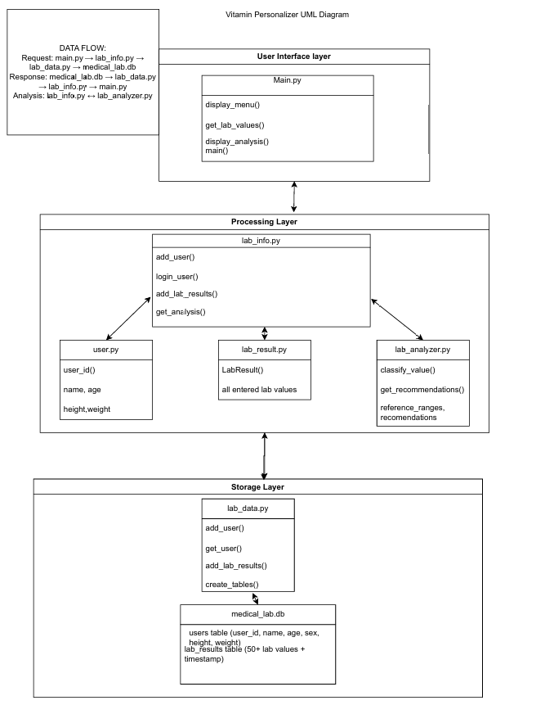
UML Diagram

Slide 8
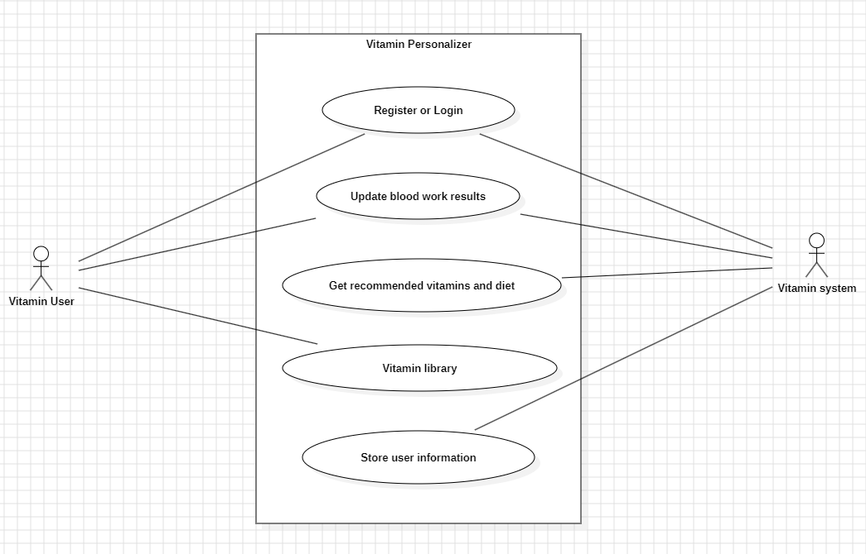
Use case diagram

Slide 9
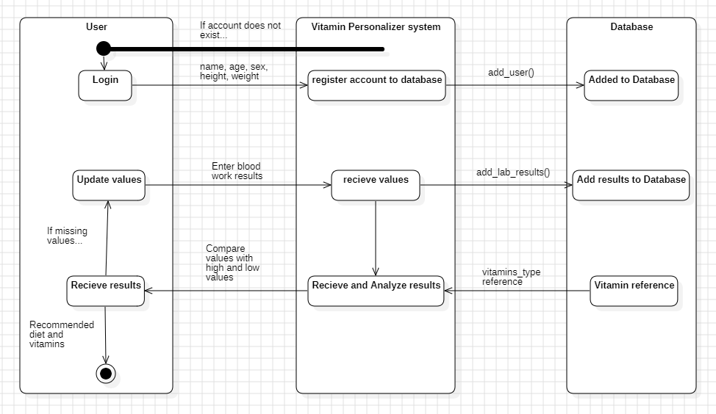
Activity Diagram

Slide 10
Software Components
main.py :Central interface and application controller
lab_analyzer.py :Blood work analysis and recommendation engine
lab_data.py : SQLite database operations and data management
user.py :Authentication and user profile management
lab_result.py : Data structures for storing test results
vitamin_vocabulary.py :Vocabulary content of all about vitamins​​​​​​​​​​​​​​​​

Slide 11
System Requirements
Hardware Requirements:
Windows 10 Operating System
4GB RAM minimum
10GB free storage space
Software Requirements:
Python
SQLite Database integration
Install PDF Generation Libraries

Slide 12
Test Cases #1
Account Registration (VP-01 AR)
Should register the user with a valid name, age, sex, height, weight, and BMI. At the end, the user should be given a unique ID, indicating a successful registration.
New Blood work results (VP-02 BL)
The user enters lab results for all 50 vitamins listed for the first time. The user can leave any vitamins blank to omit from analysis.
Updating Blood work (VP-03 UR)
The user should update with new values to replace old values.

Slide 13
Test Cases #2
High and Low Value Testing (VP-04 HL)
Use predetermined values for the 50 vitamins listed to test the accuracy of the lab analyzer component. Results should be labeled either low or high and the component should correctly display the corresponding recommendations
Menu Navigation (VP-05 MN)
Go through every selection in the
menu to check that the system displays the corresponding screen correctly.
Account Login Verification (VP-06 LV)
Test the account verification system. The user is locked out by default until they log back in with a registered name and ID. The user should be allowed once they input the correct name and ID. Otherwise, they are denied access to the Vitamin Personalizer.
PDF Generation (VP-07 PG)
The PDF Generator should print out the user’s current lab results after completing analysis or through Progress Check.

Slide 14
Defect report
DBC_01: Database Connection through updating values (Minor/closed)
Old and new values conflicting as a result of updating with new vitamin inputs.
PDF_02: PDF Generation error through Progress Check (Minor/Closed)
Error regarding PDF printout of user results from the Progress Check screen.

Slide 15
Overview of SRS
Purpose: To provide specifications for developers and cover the description, functional and non-functional requirements, and interface characteristics as reference.
Scope: To give personalized vitamin and diet recommendations based on blood work results with clear explanations.
Objective: Provide and explain the details of reach requirement for the Vitamin Personalizer.
Key Highlights:
Overall Description of Vitamin Personalizer
Functional/Non-Functional Requirements
External Interface Requirements

Slide 16
Overview of SDD
Purpose: To detail the design and architecture of the software and its implementation.
Scope: Provide various diagrams, components, and design outlines of the Vitamin Personalizer.
Objective: Display various components and diagrams to provide a detail description and explanation of the Vitamin Personalizer’s functionality.
Key Highlights:
UML Design Diagram
Use Case Diagram
Activity Diagram
ER Diagram
Module Components (7 components)

Slide 17
Overview of STD
Purpose: To test that the vitamin recommendations are as accurate as possible
Scope: Go over each functionality of the components and various test cases
Objective: Verify the performance of the software and document any errors or false recommendations, through 50 vitamins tests.
Key Highlights:
Test Cases/Procedure/Execution Reports
Defect Report
Test Summary

Slide 18
Security Concerns, Challenges and Solutions
Current Security:
Unique ID system for user authentication and SQL database access
Local data storage on user’s device for complete privacy
Basic ID-based login to access and update health information
Security Limitations:
Potential brute force. IDs could be systematically guessed
Single-layer authentication currently in place
Future Enhancements:
Security questions planned for additional login verification
Multi-factor authentication consideration.

Slide 19

Example of software:

Slide 20
Conclusion:
Overall: The Vitamin Personalizer, while still needing more testing and fixing before release, its components work and function as expected and efficiently. The majority of the system is functional and stable for vitamin recommendations for the general public.
Summary results:
Total Test Cases Executed: 7
Pass/Fail Ratio: 5 passed, 2 failed
Defects Found: 2 minor defects
71% (5/7 test cases) success rate
Key Findings:
Strong verification functionality with account registration
Highly effective analysis on vitamin values and recommendations
Proficient Data Storage

